Slide 1
Learning Deconvolution Network for Semantic Segmentation
Ajou Univ. software dep. 201920723 김동욱
Kim Dong Wook
ICCV 2015

Slide 2
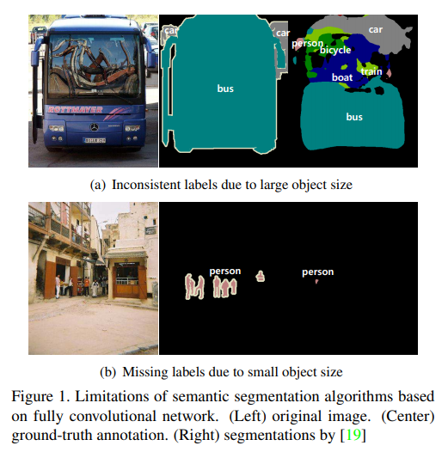
Limits of FCN
Fixed-size receptive field

Slide 3
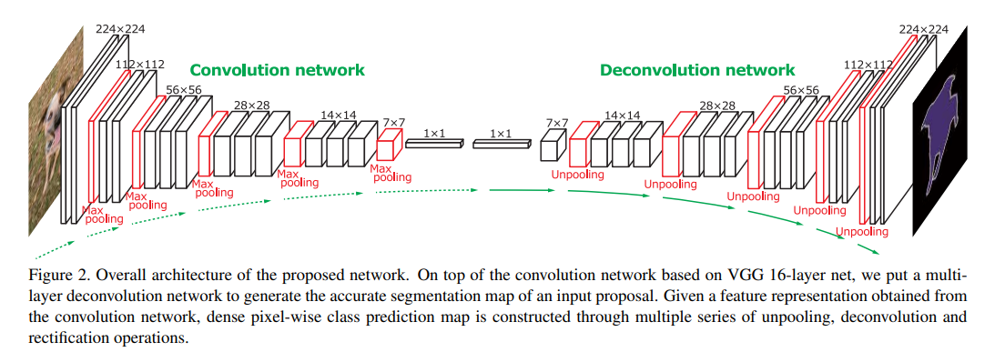
Architecture

Slide 4
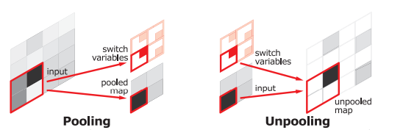
Unpooling
Pooling is designed to filter noisy activations
But also lose spatial information
Used switch variables with unpooling
Locality

Slide 5
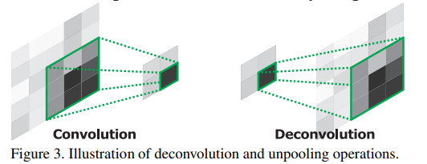
Deconvolution
Unpooled feature map is an enlarged, yet sparse
Deconvolution layers densify
Learnable
Crop after deconvolution
Reconstruct shape of input object

Slide 6
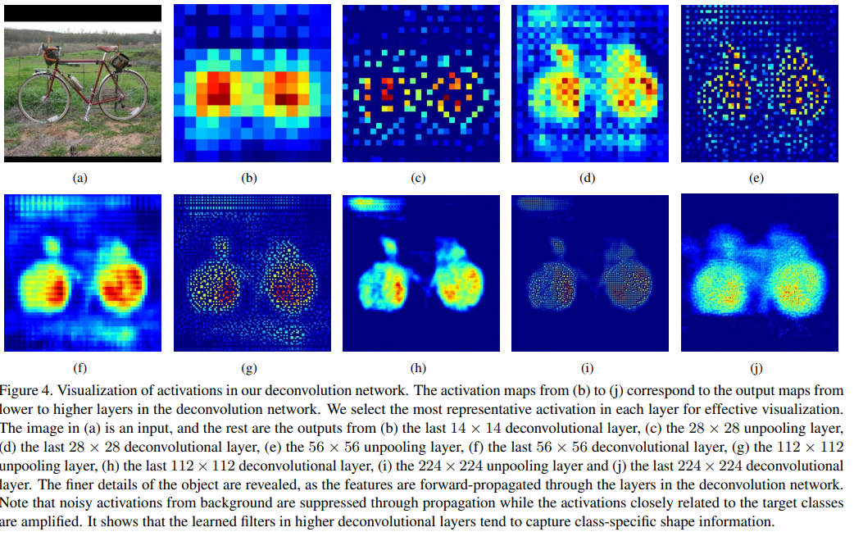

Slide 7
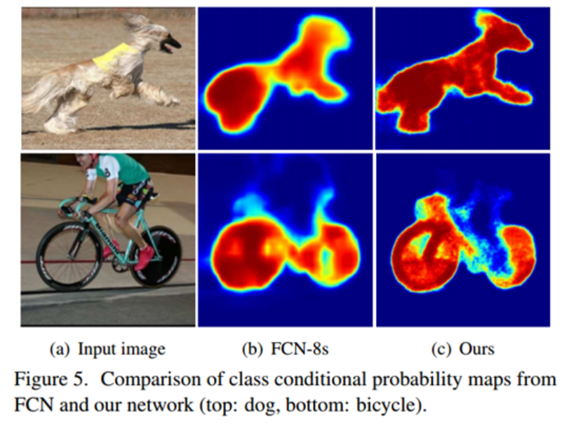
Precise results

Slide 8
training
Batchnorm for optimization
Two stage training

Slide 9
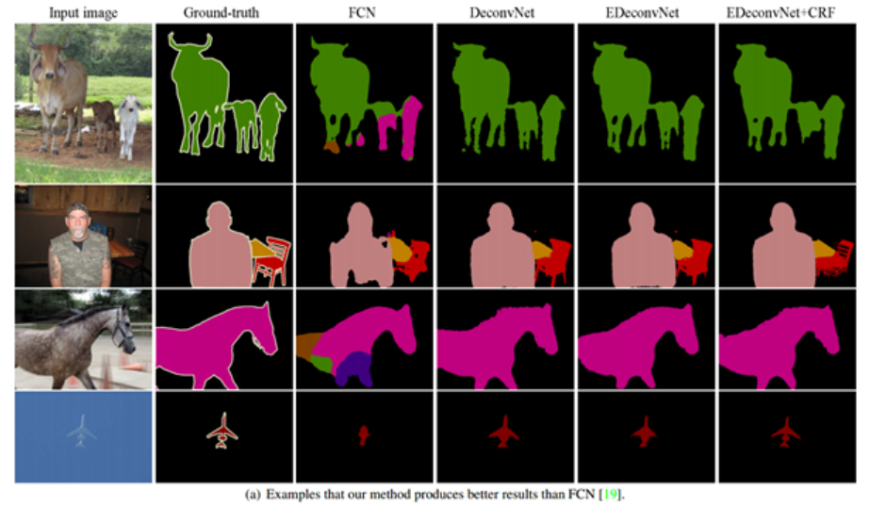
Use with other ideas

